Slide 1

BCI Project
Giulio Lecci 1000002090
Dataset: s27

Slide 2
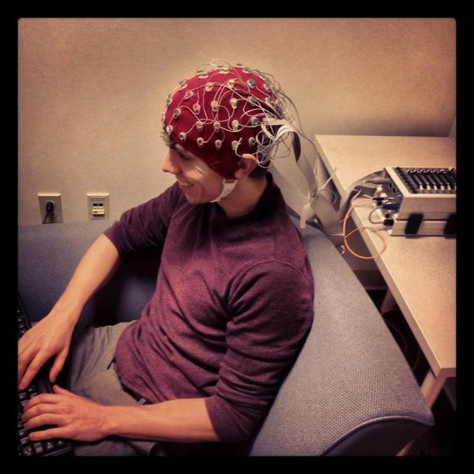
Project Specifications
Analysis of EEG signals, recorded on 52 people (19 females and 33 men).
Signal composed of 64 channels with electrodes placed as the 10-10 International system.
Biosemi ActiveTwo system used as recording device with a sample rate of 512 Hz.
Subjects are asked to compute motor imagery trials, so to imagine hand movements basing on the instruction given. Hence, this is an Active BCI system (as reported in the device used).

Slide 3
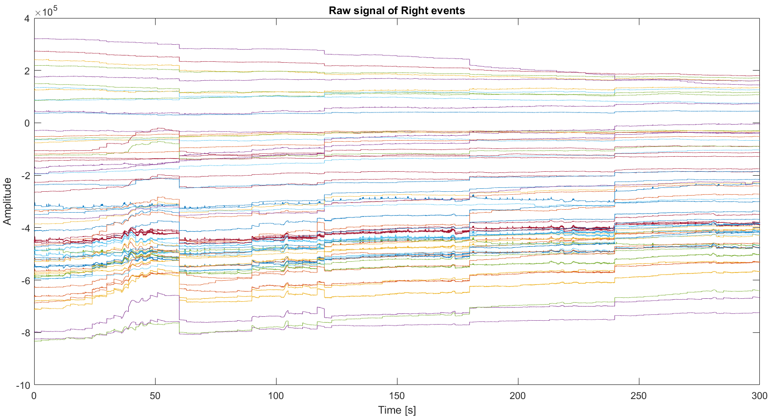
Dataset Inspection
Plotting the entire raw (unfiltered) signal in time, made of all the channels and not divided in epochs. It appears how all the channels have many characteristic points in common, this is the case of the "cliff" reported at almost 60 seconds. Many shared behaviors can be seen by looking at the graph.
Moreover, as it can be seen, the mean value of each channel is directly related to the position of each electrode as they all share almost the same shape but with different amplitudes. So, the further is the electrode from the interested part of the brain (motor area, in this case), the closer to 0 will be the amplitude recorded.
Another interpretation of this "signal placement" can be a voluntary offset of the mean value of each channel, done on purpose to allow a complete overview with a single plot. Those not zero mean values explain the great peak at low frequency (that will be observed later), since those are constant contributes.
This plot shows the raw signal of right events, but the same reasoning can be done for left ones
This is true for almost every consideration of this report.

Slide 4
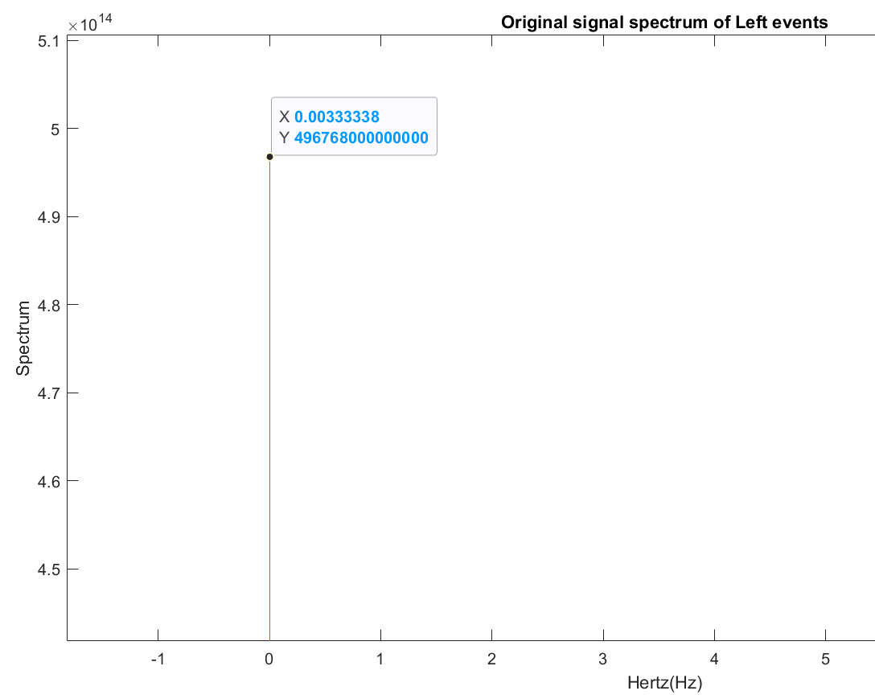
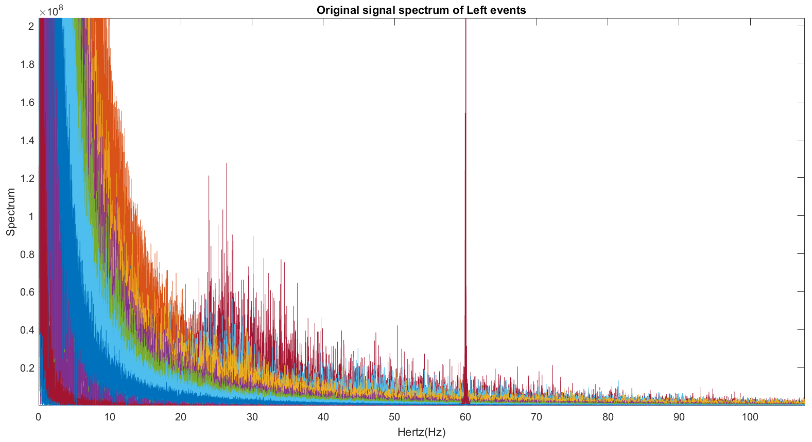
Dataset inspection – Artifacts recognition
Look carefully at the y axis value of this low frequency peak.
Analyzing the energy spectral density of the raw signal (same signal of the previous slide, different analysis) some artifacts can be found:
A huge peak can be seen at frequencies very close to 0, it's clearly an artifact since it's totally out of range.
Furthermore, the power supply artifact can be found at 60Hz (so data were probably recorded in US), and other peaks can be noticed in the range of β waves (13-40 Hz). But more than an artifact those are likely to be a sign that a motor imagery activity has been recorded, since this type of task is based on them.
In any case, those artifacts can be removed individually (with notch filter at 60Hz and high pass filter to remove low frequencies peaks) or all together by analyzing only the bandwidths related to MI activity, so the β and µ bandwidths, respectively the ones related to intense mental activity and quiet mental state.

Slide 5
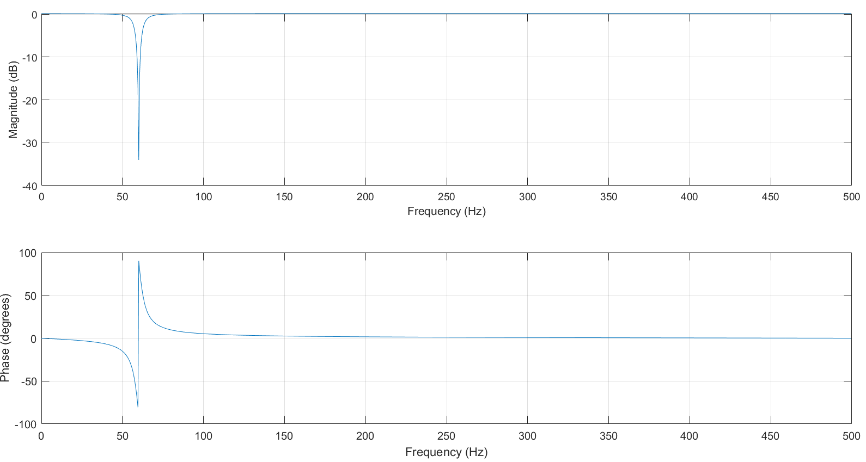
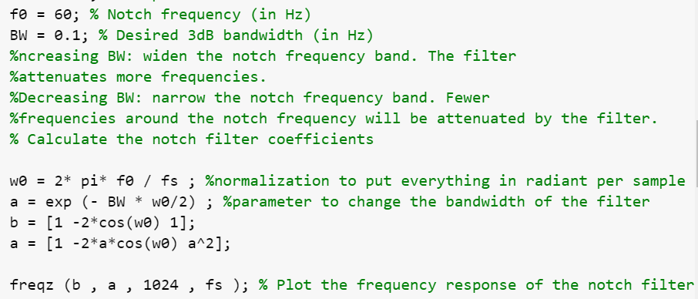
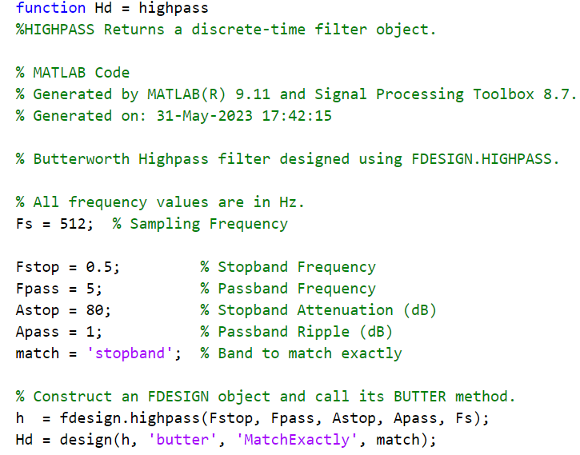
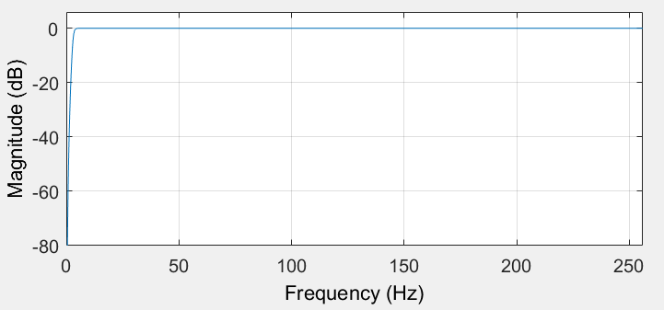
Filtering
Artifacts seen before can be deleted using appropriate filters:
Being the power supply artifact a single peak in the energy spectrum at 60Hz, a notch filter can be designed to remove it.
While for the great peaks found at low frequencies, a high pass filter is required. Applying it, all constant contributes are cancelled since they have zero frequency. Furthermore, the majority of physiological artifacts can be found at low frequencies, so it can be filtered out with the high pass filter.

Slide 6
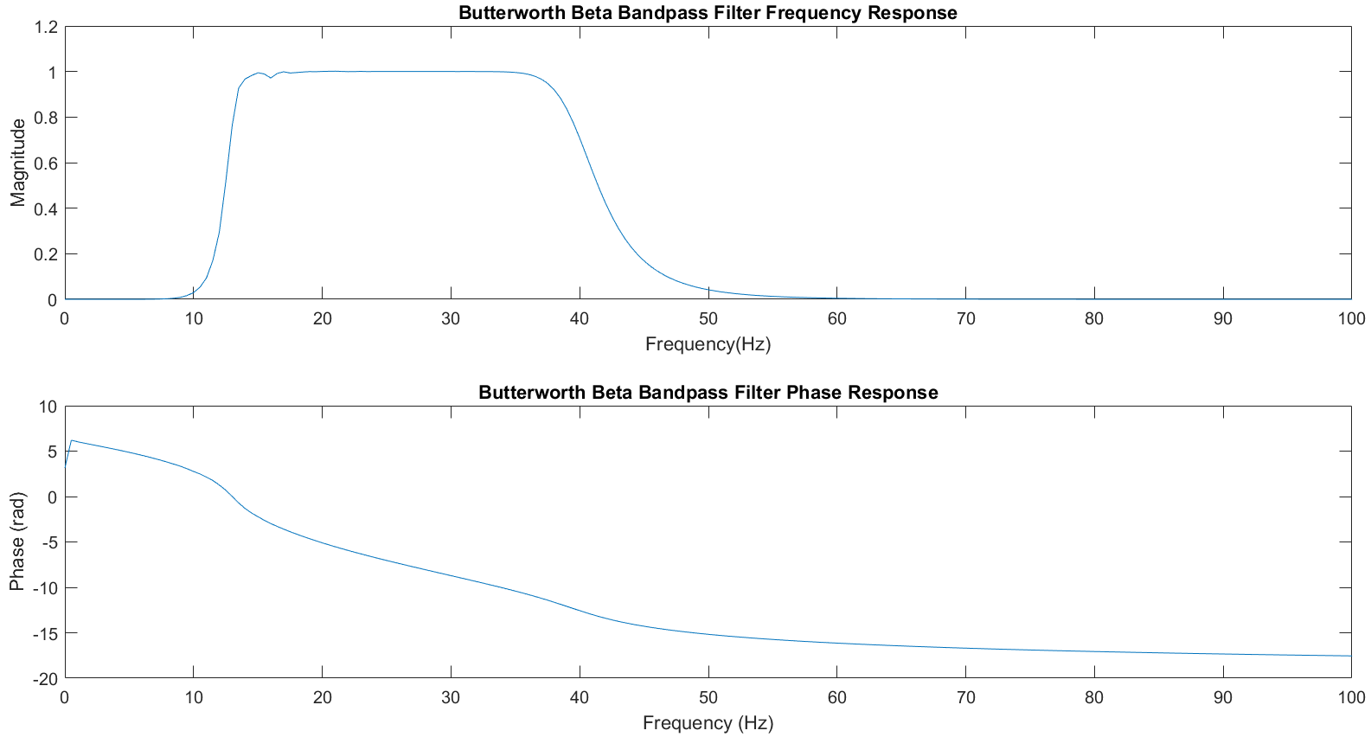
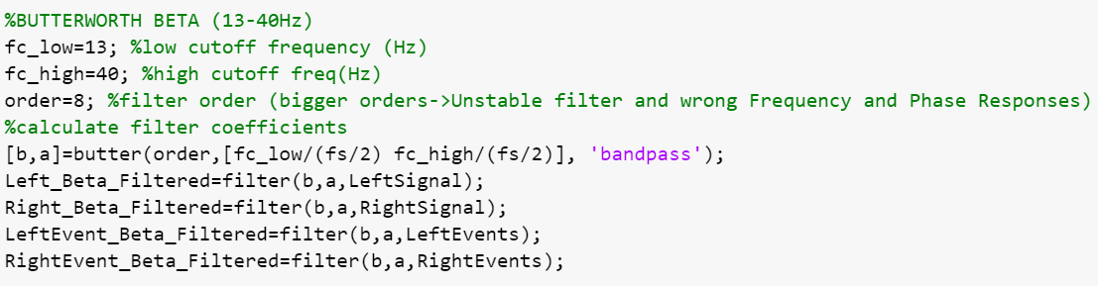
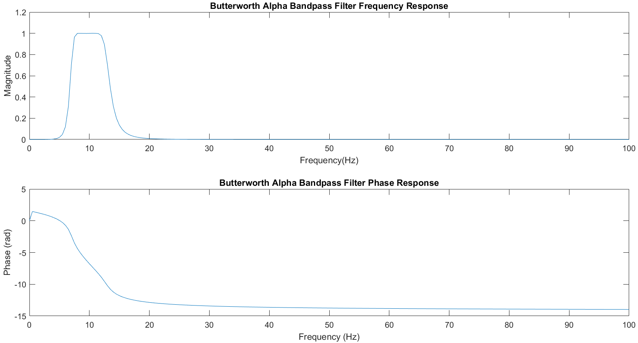
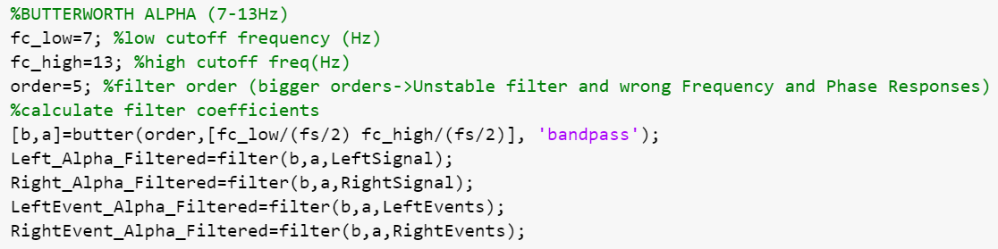
Filtering
Finally, another filtering operation is needed to properly identify frequencies related to the motor imagery trials. In particular, µ-band (7-13Hz) and β-band(13-40 Hz) frequencies are observed by using Butterworth bandpass filters. Those bandwidths are not affected by the artifacts shown before, so filtering directly into those frequencies is the best operative choice.
Note that Butterworth filters are, for definition, IIR (Infinite Impulse Response) filters. Therefore, the phase response will always be nonlinear, as it can be seen from the reported graphics.
Finally, since those 2 bandwidths are contiguous, a single bandpass filter can be implemented.

Slide 7
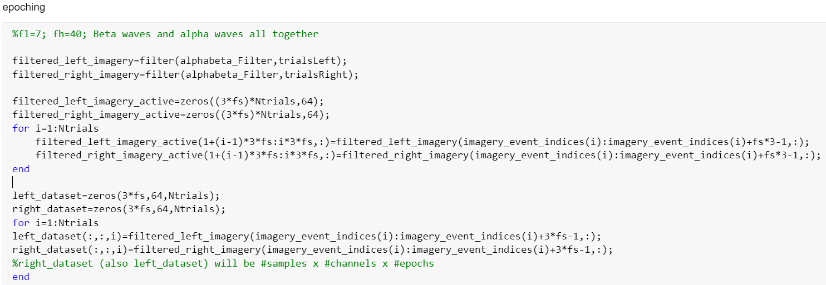
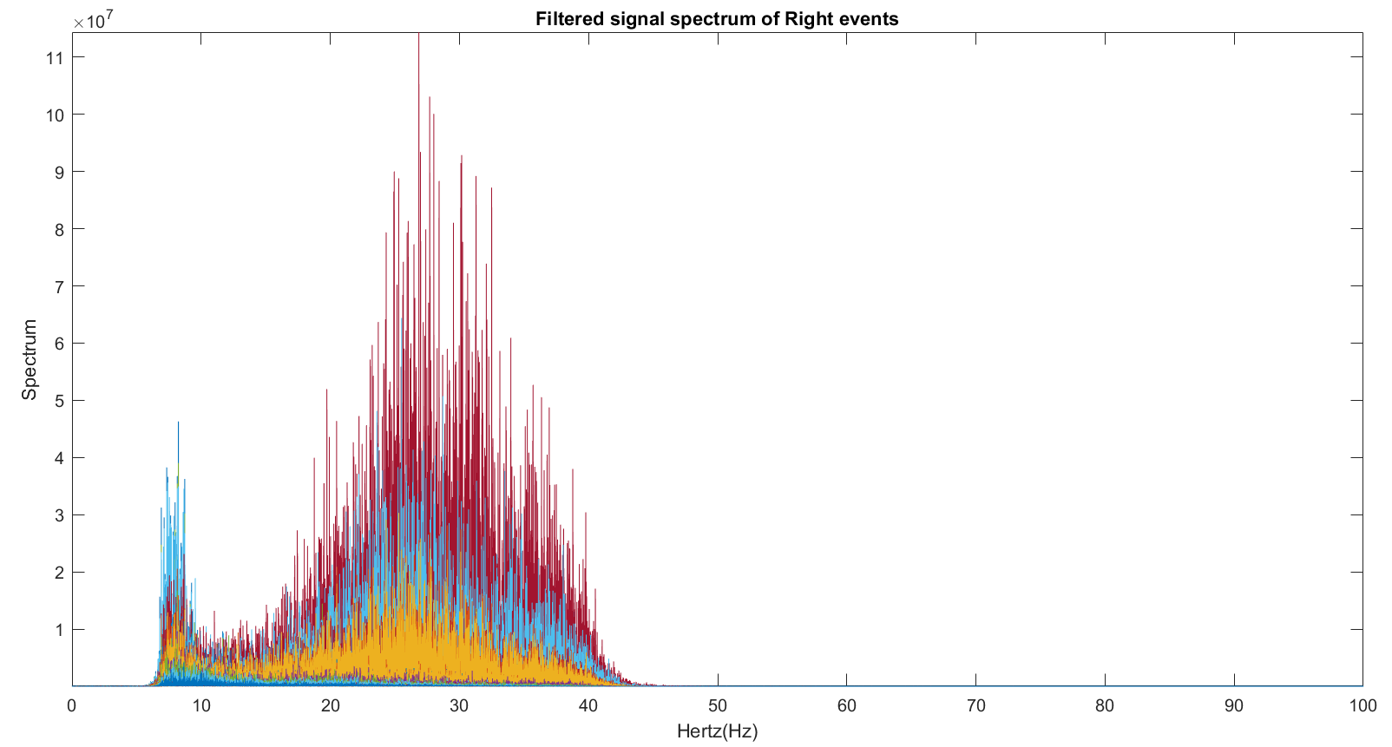
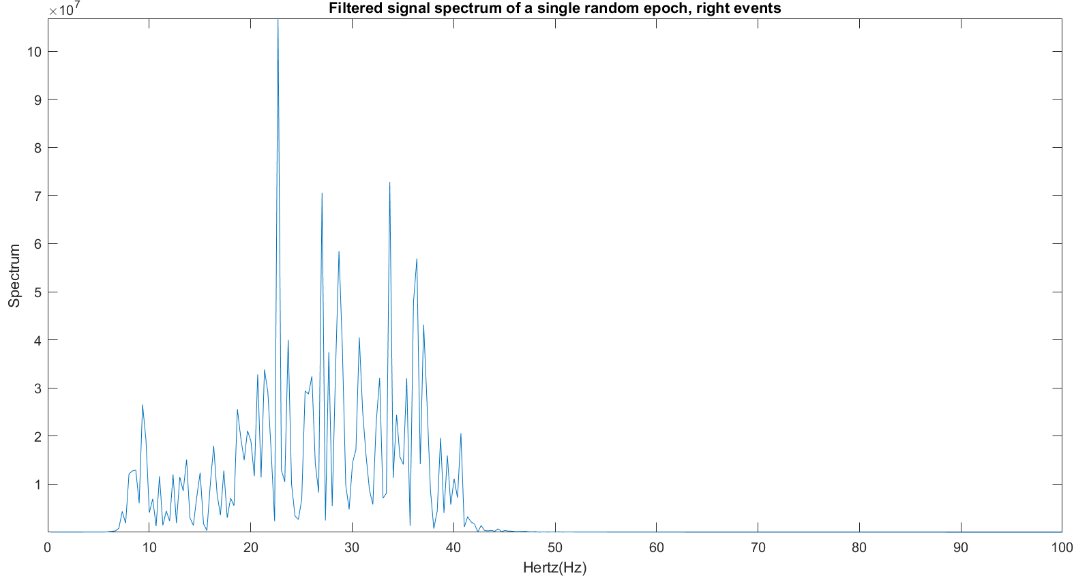
Epoching
A single dataset contains, among other data, 68 channels (but only the 64 related to EEG will be analyzed). Each of them bears information about the entire recording of several MI trials. Every trial lasts a little more than the MI effective phase, since each phase is preceded and followed by a rest phase. So epoching is necessary to isolate interesting data from rest related ones. In this way, each epoch will contain only a 3 seconds recording related to a single MI trials, and each channel will have 100 (the number of trials) epochs.
Note that epoching has been done after the filtering, so after artifact removal. Spectrums of the obtained (filtered) signals are shown.
All epochs, all channels
Single epoch, single channel

Slide 8
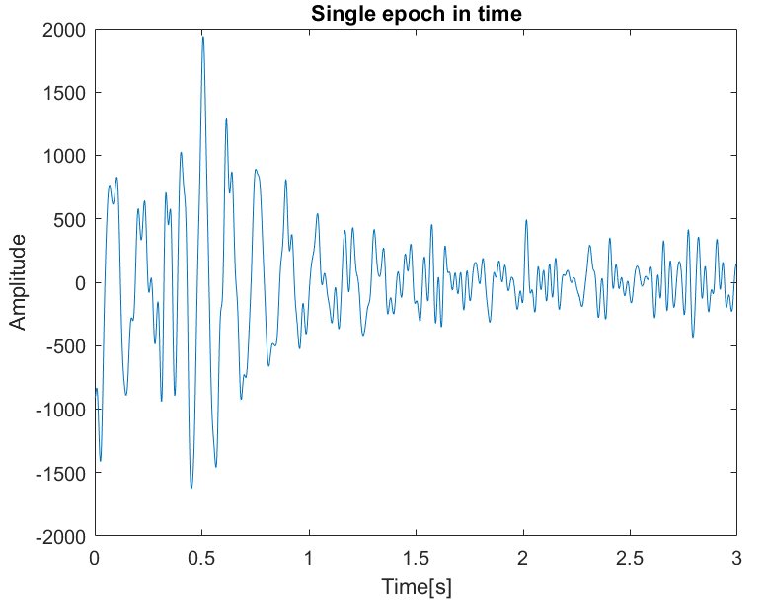
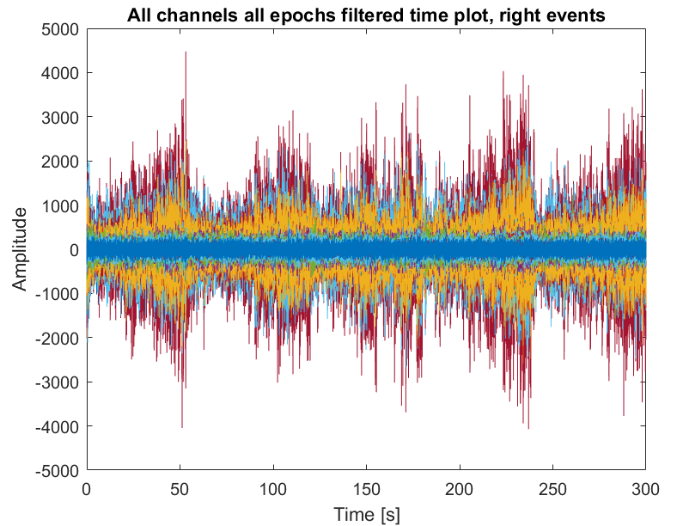
Dataset inspection- after epoching
Analyzing the single epochs, well known behaviors can be found. In the first plot can be seen how the sensorimotor rhythm desynchronizes during the motor imagery trial. Note that at t=0 the subject receives the instruction on which hand has to move and after 0.5 seconds (reaction time) the MI characteristic behavior begins.
Looking at all the 100 epochs together some peaks in time can be seen, being quite big with respect to the rest of the dynamics, they may be classified as artifacts.

Slide 9
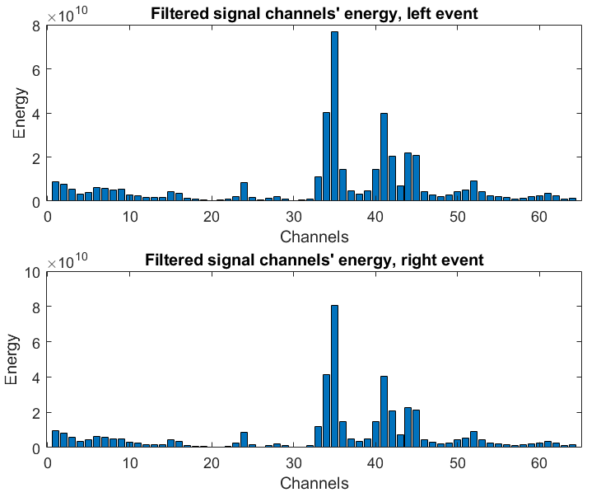
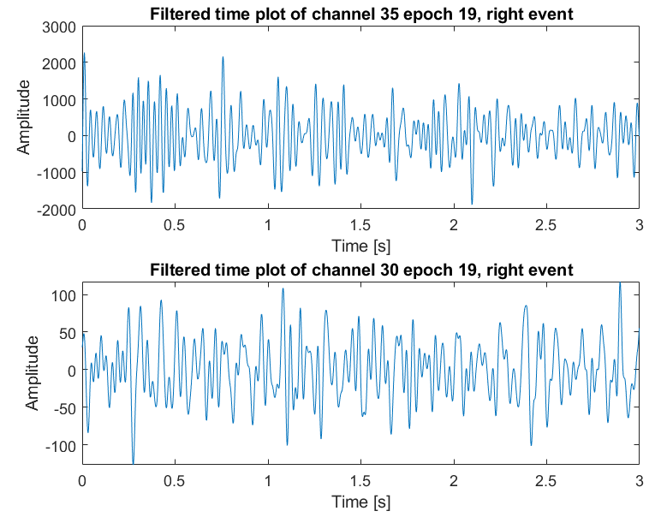
Dataset inspection-after epoching
Inspecting the dataset from an energetic point of view, it appears that realistically there aren't any differences between right and left events. As can be seen from the bar plots reported.
Moreover, by comparing the most energetic channel and the least energetic one, a huge difference in the amplitude appears in their epochs. This, due also to the shape of the signal, can be a sign of bad trials and can also depend on the position of the electrodes related to those channels.

